Slide 1
Rock Paper Scissor
Submitted to: Vinay Kumar
Rhea Shrivastava
Submitted by: Aanya Goel
Dishant Sharma

Slide 2
CONTENTS
OVERVIEW
FEATURES OF PROJECT
ADVANTAGES
TECHNICAL LEARNING

Slide 3
OVERVIEW OF PROJECT
The main objective of the rock-paper-scissor project is to build a game for a single player that plays with a computer, anywhere, and anytime. In this project, players have to choose any one from rock, paper, and scissors. Then click on the play button will show the result of the game. This project is base on the rules that:
rock blunts scissors so rock wins
scissors cut the paper so scissors win
paper cover rock so paper wins

Slide 4
FEATURES OF THE PROJECT
ROCK PAPER SCISSOR is a zero-sum game, it has three possible outcomes: a draw, a win or a loss.
A player who decides to play rock will beat computer who has chosen scissors ("rock crushes scissors" or "breaks scissors" or sometimes "blunts scissors"),but will lose to one who has played paper ("paper covers rock"); a play of paper will lose to a play of scissors ("scissors cuts paper"). If both players choose the same shape, the game is tied and is usually immediately replayed to break the tie.
Any of these outcomes will get a score that would be calculated in the last when the player wants to exit the game.

Slide 5
ADVANTAGES
Rock paper scissors is often used as a fair choosing method between two people, similar to coin flipping, drawing straws, or throwing dice in order to settle a dispute or make an unbiased group decision.
This game can also be played to relax the mind of a person when he or she is in stress.
Mental preparation helps you with focus, consciousness, concentration, and control of your mind. All these are the benefits player get to enjoy playing the Rock Paper Scissors game.

Slide 6
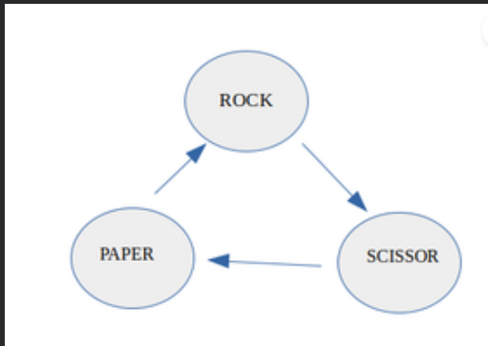
TECHNICAL LEARNING
With the help of strings and function this project is made.
In the real game of Rock-Paper-Scissor, the rock dominates over the scissor, scissor dominates over the paper and paper dominates over the rock.The game can be modelled using a directed graph as below, in which the directed edge (a, b) shows that a dominates over b.

Slide 7
DIRECTED GRAPH

Slide 8
SAMPLE CODE OF THE PROJECT

Slide 9
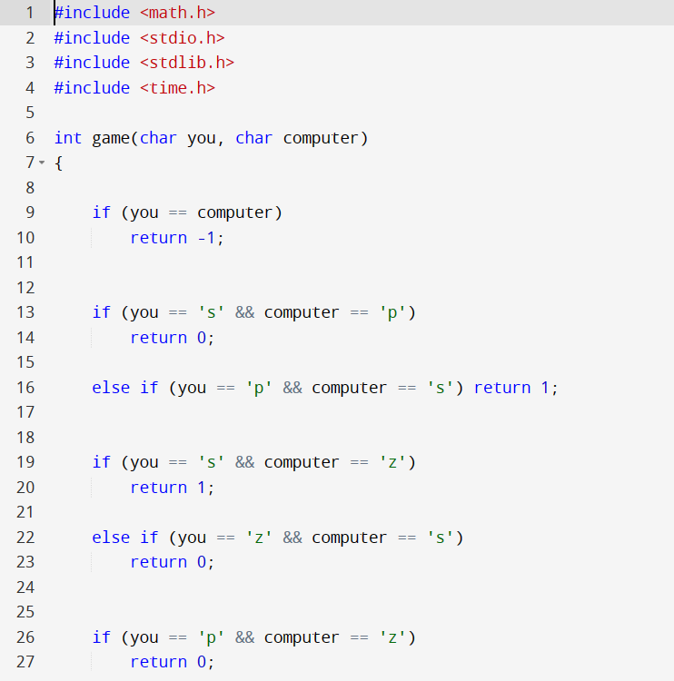
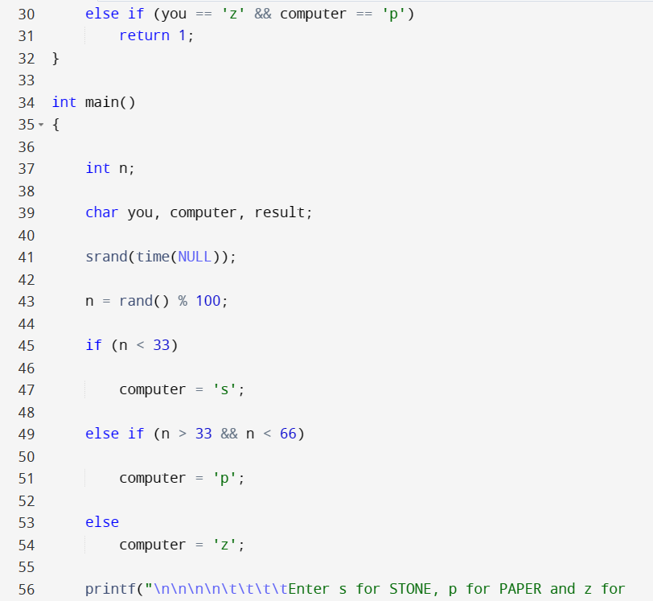
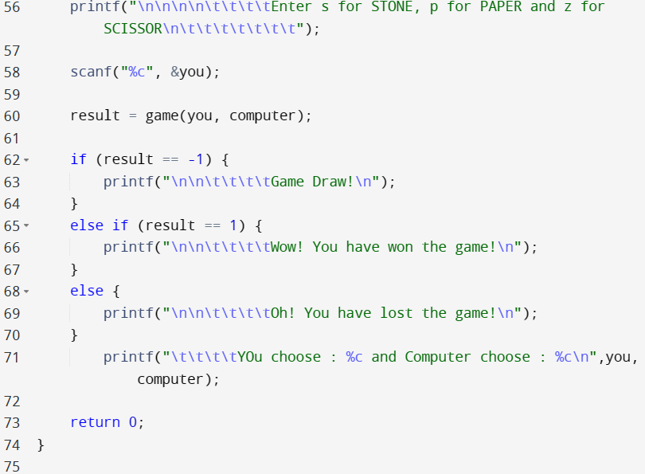

Slide 10
OUTPUT SCREENSHOT

Slide 11
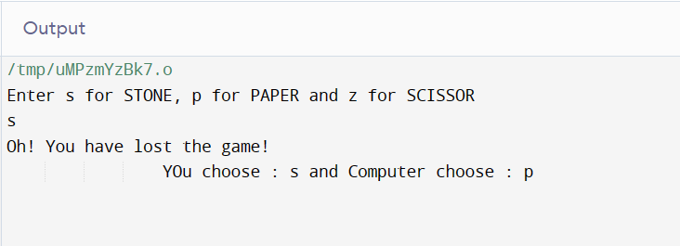

Slide 12
THANK YOU

